Slide 1
2D game characters and animation
Course : 2D Game Programming
Effective Period : September 2018

Slide 2
These slides have been adapted from: Pereira, V. (2014). Learning Unity 2D Game Development by Example, Packt Publishing, Inc. San Francisco. ISBN: 9781783559046 Chapter 3
Acknowledgement

Slide 3
Learning Objectives
LO 1 : Create 2D game for PC platform
LO 3 : Design 2D game for PC platform

Slide 4
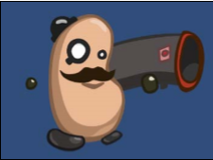
What is a sprite?
A sprite is a 2D image or animation (sequence of images) that we can manipulate on screen.
Image source:
Pereira, V. (2014). Learning Unity 2D Game Development by Example. Packt Publishing, Inc. San Francisco.

Slide 5
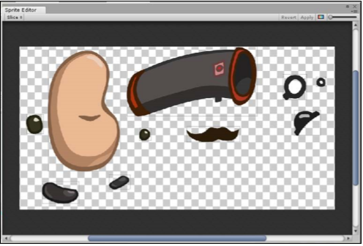
Spritesheet
A sprite sheet is an image consisting of separate multiple images. The following screenshot shows a sprite sheet made up of multiple images for the parts of the body
Why should we
separate them?
Image source:
Pereira, V. (2014). Learning Unity 2D Game Development by Example. Packt Publishing, Inc. San Francisco.

Slide 6
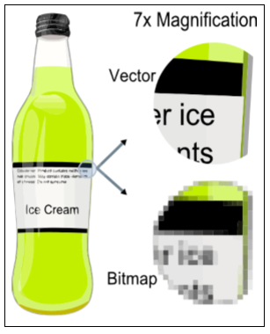
Raster image or Vector Image?
When we create a sprite, we need to ensure that we use a raster image as Unity does not support vector images.
A raster image, also known as a bitmap, is an image made up of bits that translates into pixels defined according to a grid of pixel (picture element) colour values. Vector images are without grids and use a mathematical formula that defines points and paths that connect to form an image. Thus, when magnified, a raster image looks very pixelated whereas a vector image looks very clear.
Image Source
http://en.wikipedia.org/wiki/Vector_ graphics#mediaviewer/File:VectorBitmapExample.svg

Slide 7
File Formats
Unity supports the following 2D formats: PSD, TIFF, JPG, TGA, PNG, GIF, BMP, IFF, and PICT.
We will make use of PNG because it is the most used, lossless image compression format, and it supports varying levels of alpha transparency per pixel, which can be useful when our sprite features things like tinted glass.

Slide 8
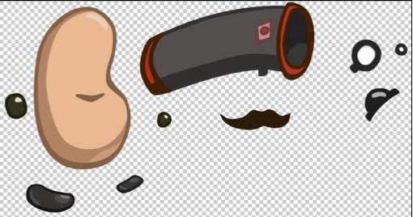
Example images can be downloaded from
https://www.assetstore.unity3d.com/#/content/11228

Slide 9
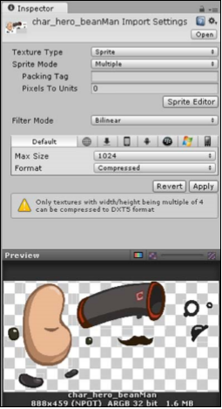
Import the sprite
To import a sprite, we repeat the process that we followed when importing a background. We drag the sprite from its location on our PC into the Project Browser and then set its Texture Type option to Sprite within the Inspector view. The only difference is that this time, we set the Sprite Mode drop-down box to Multiple since our single character sprite is made up of multiple images. Once we are done setting the import settings, we hit Apply.
Image source:
Pereira, V. (2014). Learning Unity 2D Game Development by Example. Packt Publishing, Inc. San Francisco.

Slide 10
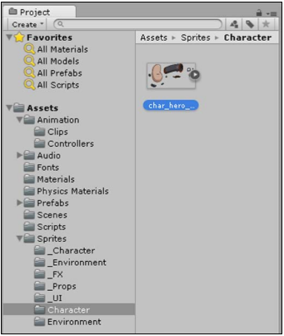
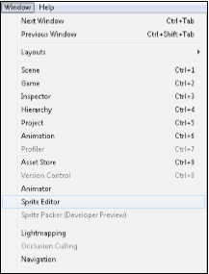
Sprite Editor
To slice a sprite sheet, we need to open the Sprite Editor either by selecting Sprite Editor within the Inspector toolbar during Import settings or by first selecting the image in the Project Browser
Image source:
Pereira, V. (2014). Learning Unity 2D Game Development by Example. Packt Publishing, Inc. San Francisco.

Slide 11
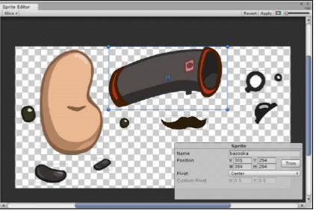
Manual Slicing
To slice each image into its own sprite manually, we first drag and select the image within the Sprite Editor window. A blue selection area box will then be displayed
Image source:
Pereira, V. (2014). Learning Unity 2D Game Development by Example. Packt Publishing, Inc. San Francisco.

Slide 12
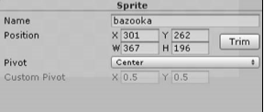
Sprite Editor
We resize the selection area by dragging and moving the handles on the corners of the box to fit around one of the multiple images. We do the same for all the other images within the sprite sheet. We can also name, set the size, and position the box within the Sprite box
Image source:
Pereira, V. (2014). Learning Unity 2D Game Development by Example. Packt Publishing, Inc. San Francisco.

Slide 13
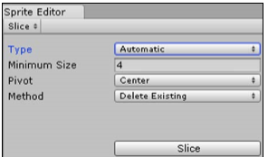
Automatic slicing
To save us time, Unity provides several options for the automatic slicing of the sprite sheet.
We leave the Type drop-down box at its default option as Automatic as we simply want to slice our sprite sheet automatically. When set to Automatic, Unity decides where to place the selection area boxes that separate the multiple images based on the full transparency surrounding the images. It can tell where an image is by checking whether each pixel within the image is opaque or slightly transparent; otherwise, if it is fully transparent, Unity can tell that it is not part of the image and therefore surrounds it.
Image source:
Pereira, V. (2014). Learning Unity 2D Game Development by Example. Packt Publishing, Inc. San Francisco.

Slide 14
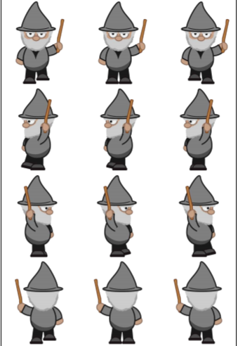
Slicing Type
GRID
When we use a sprite sheet that is divided into equally sized images, then we use the grid type for automatic slicing as this speeds up the image slicing process significantly.
Image source:
Pereira, V. (2014). Learning Unity 2D Game Development by Example. Packt Publishing, Inc. San Francisco.

Slide 15
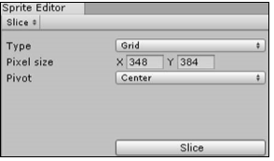
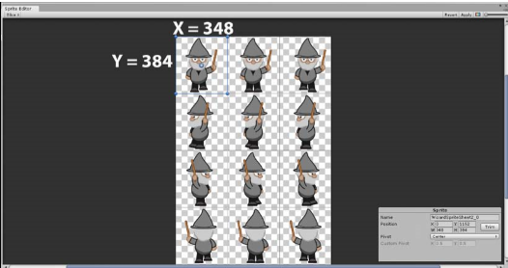
Slicing Type
GRID
When we select the Grid option from the Type drop-down box
Image source:
Pereira, V. (2014). Learning Unity 2D Game Development by Example. Packt Publishing, Inc. San Francisco.

Slide 16
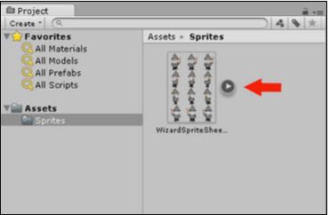
Viewing Sprite
Image source:
Pereira, V. (2014). Learning Unity 2D Game Development by Example. Packt Publishing, Inc. San Francisco.

Slide 17
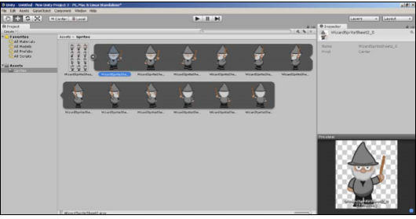
Viewing Sprite
Image source:
Pereira, V. (2014). Learning Unity 2D Game Development by Example. Packt Publishing, Inc. San Francisco.

Slide 18
Texture Atlasing
When working with sprites, it is easier and more convenient to use a separate image (otherwise known as a texture file) for each character. However, the image will usually have a lot of empty space surrounding it, and this takes up video memory during runtime (when the game is running), which impacts performance.
In order to reduce the wastage and optimize performance, we make use of texture atlasing. A technique called draw call batching that Unity and other engines use also helps to improve the frame rate. It too requires texture atlasing particularly for PC games, whereby a complex 2D scene would probably become CPU-bound.

Slide 19

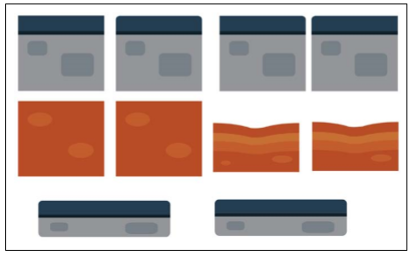
Texture Atlas
A texture atlas packs several separate images (textures) into a single texture. The following is an image representing a texture file that does not use texture atlasing
The following image represents a texture file using a texture atlas
Image source:
Pereira, V. (2014). Learning Unity 2D Game Development by Example. Packt Publishing, Inc. San Francisco.

Slide 20
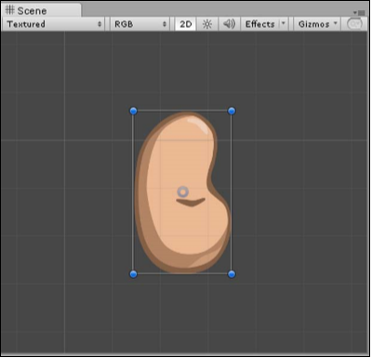
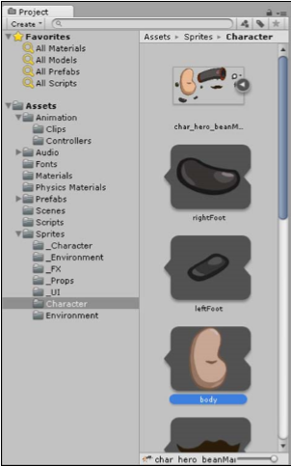
Adding The Character
To do so, we simply drag the selected sprite asset from the Project Browser
Image source:
Pereira, V. (2014). Learning Unity 2D Game Development by Example. Packt Publishing, Inc. San Francisco.

Slide 21
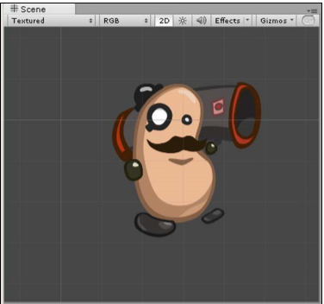
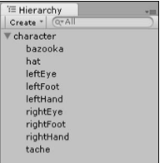
Group the image under a GameObject
Now that the GameObject appears as a character, we select the remaining body parts that will make up our character from the Project Browser, drag them to the Hierarchy tab, and drop them over the character so that the character becomes the parent and all the other parts are the children. This is to ensure that the body parts are locked to the character and inherit any changes that are applied to the character.
Image source:
Pereira, V. (2014). Learning Unity 2D Game Development by Example. Packt Publishing, Inc. San Francisco.
Image source:
Pereira, V. (2014). Learning Unity 2D Game Development by Example. Packt Publishing, Inc. San Francisco.

Slide 22
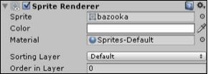
Sprite Renderer
When we select the character parent or any of its children, the Sprite Renderer component will display this selection within the Inspector toolbar. It contains all the settings that affect how the image will be rendered
Image source:
Pereira, V. (2014). Learning Unity 2D Game Development by Example. Packt Publishing, Inc. San Francisco.

Slide 23
Spriter Renderer
The Sprite field contains the reference to the sprite asset that the GameObject is using.
The Color field is a blend mode that multiplies the color selected with the sprite's original color
The Material field allows us to select the material we would like to use, which affects the image's rendering properties as well as the assets used
The Sorting Layer option is where we group a selection of sprites that we want to display on the same layer. We will leave this at its default settings.
The Order in Layer option specifies which order we want the selected layer to appear.

Slide 24
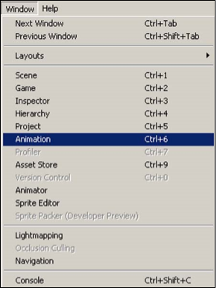
Animating Sprite
Now that we have added our character to the scene, we want to bring it to life by animating the sprite. To do so, we select our character in the Scene View or from the Hierarchy tab and open the Animation Editor window by going to the main toolbar and navigating to Window | Animation
Image source:
Pereira, V. (2014). Learning Unity 2D Game Development by Example. Packt Publishing, Inc. San Francisco.

Slide 25
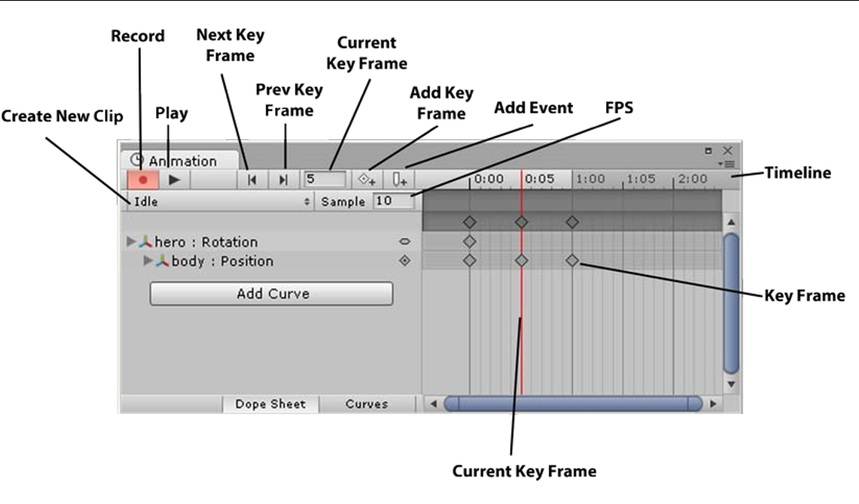
Animation Editor
Image source:
Pereira, V. (2014). Learning Unity 2D Game Development by Example. Packt Publishing, Inc. San Francisco.

Slide 26
Dopesheet 2D animation
Dopesheet is the user-interface approach used in the editor to create animation clips. The word Dopesheet is derived from its traditional use in cartoons and film/TV. Similar to a storyboard, it is used in planning animations using frames and sections
To create a reusable animation clip for our character of it breathing, follow below steps
1. We select the character, click on the Create New Clip drop-down box, and then click on Create New Clip.
2. We then select Idle as the name of our animation and click on Save.
3. Now we select Add Curve.
4. A drop-down box will appear giving us several options.

Slide 27
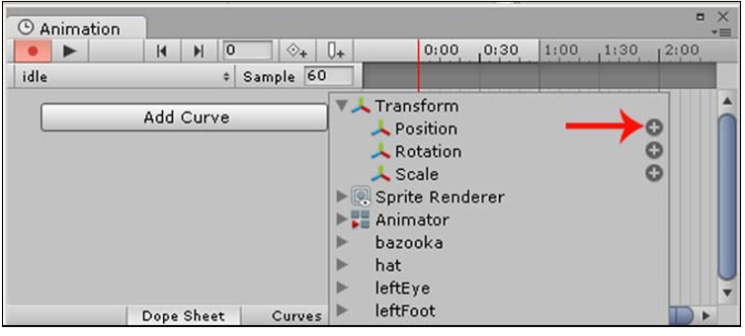
Dopesheet 2D animation
Dopesheet is the user-interface approach used in the editor to create animation clips. The word Dopesheet is derived from its traditional use in cartoons and film/TV. Similar to a storyboard, it is used in planning animations using frames and sections
5. We click on Transform to open all the transform properties and then select Position by clicking on the plus button next to it as shown in the following screenshot:
Image source:
Pereira, V. (2014). Learning Unity 2D Game Development by Example. Packt Publishing, Inc. San Francisco.

Slide 28
Dopesheet 2D animation
Dopesheet is the user-interface approach used in the editor to create animation clips. The word Dopesheet is derived from its traditional use in cartoons and film/TV. Similar to a storyboard, it is used in planning animations using frames and sections
6. We will animate our character breathing by moving its body's position up and down slightly.
7. We need to reduce the frames per second (FPS) from 60 down to 10 so that the animation is slower and smoother as this property controls how many frames are played per second.
8. The record button should already be pressed down when the button is red because adding a new curve automatically enables recording. If we have accidentally disabled it, we press the record button and move our character up slightly in the Scene View or the Inspector to change its position for the first frame. This will add a key to the frame resulting in a key frame. When moving our character within the Scene View, we can hold the Shift key while dragging to ensure that we move it in a straight path and the Ctrl key snaps the sprite along a grid defined in Edit | Snap Settings.

Slide 29
Dopesheet 2D animation
Dopesheet is the user-interface approach used in the editor to create animation clips. The word Dopesheet is derived from its traditional use in cartoons and film/TV. Similar to a storyboard, it is used in planning animations using frames and sections
9. We then type 5 within the current key frame to add a new key frame, and move the character down again.
10. Finally we add 10 to the current key frame and move the character up once again to add the final key frame.
11. We then click on the record button to stop recording and press play to view our animation. We must not forget to stop recording! Otherwise, we will inadvertently record things in our animation that we did not mean to.
12. To delete any key frames, click on the key frames to select them, and then press Delete.
13. Now when we play our game from the Game View, we will see our character animating—our character is alive!

Slide 30
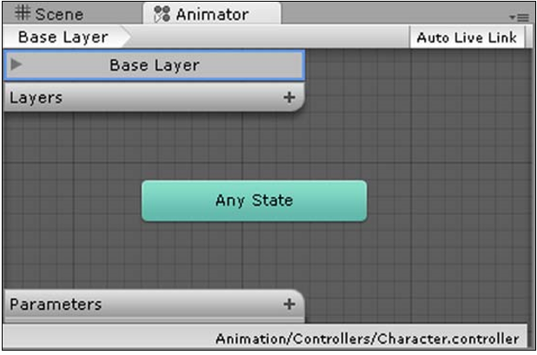
Animator
The Animator allows us to switch between multiple animations (or states) when certain game conditions occur. For example, when a character is in a jumping state, Unity will automatically enable the jump animation. We define which character states correspond to the animations in the Animator View.
To open the Animator, we go to the main toolbar and navigate to Window | Animator. The Animator Window will open and look as follows:
Image source:
Pereira, V. (2014). Learning Unity 2D Game Development by Example. Packt Publishing, Inc. San Francisco.

Slide 31
Animator
Now, we add our character's idle animation to the Animator by simply dragging the idle animation from the Project Browser and dropping it into the Animator View.
We then right-click on the Any State option within the Animator, select Make Transition, and then click on the idle animation state. We now have the any state transitioning into the idle animation.
We use Any State when we want to jump to a state (an animation to play) no matter what state our character is in.
We then right-click on the idle state and select Set As Default to set the idle state to run when we first run the game. By default, this should already be the case, and therefore, Set As Default will be grayed out but is worth noting in case we accidentally set a different animation state as default.

Slide 32
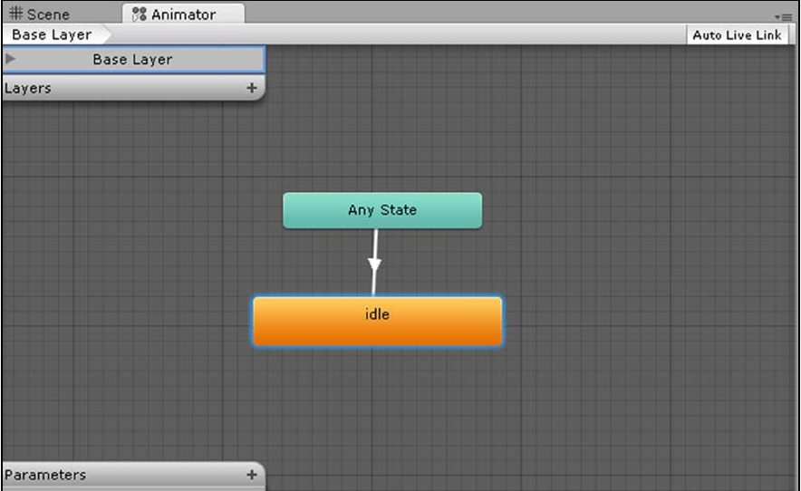
Animator
Run the scene/game by pressing play in the Game View to see our character come alive!
Image source:
Pereira, V. (2014). Learning Unity 2D Game Development by Example. Packt Publishing, Inc. San Francisco.

Slide 33
Discussion
List games with great 2D animation? Was it using spritesheet? Or using skeletal animation? Or it simply transform the movement?
Spritesheet VS Image Transform

Slide 34
References
Freeman, J. (2015). Unity’s New 2D Workflow
Vidyasagar. (2014. Unity and C#: Game Loop.CodeProject
Pereira, V. (2014). Learning Unity 2D Game Development by Example. Packt Publishing, Inc. San Francisco. ISBN: 9781783559046

